Slide 1

Student Informative Chatbot System
Batch No: B-07 Project Guide:
Sai Lekhya K (164G1A0588) Mr. R. Sandeep Kumar, M.Tech.
Satheesh G (164G1A0593) Assistant Professor
Ranjitha P (164G1A0577)
Sneha K (164G1A05A0)
Srinivasa Ramanujan Institute of Technology
Department of Computer Science & Engineering

Slide 2
Abstract
Chatbot is an automation system and different formats of chatbots are command-line, graphical, web application, and voice based. Chatbots typically provide a text-based user interface, allowing the user to type commands and receive text as well as text to speech response. The functionality of a Chatbot works only on the existing commands. Chatbots usually remember previous commands in order to provide functionality.

Slide 3

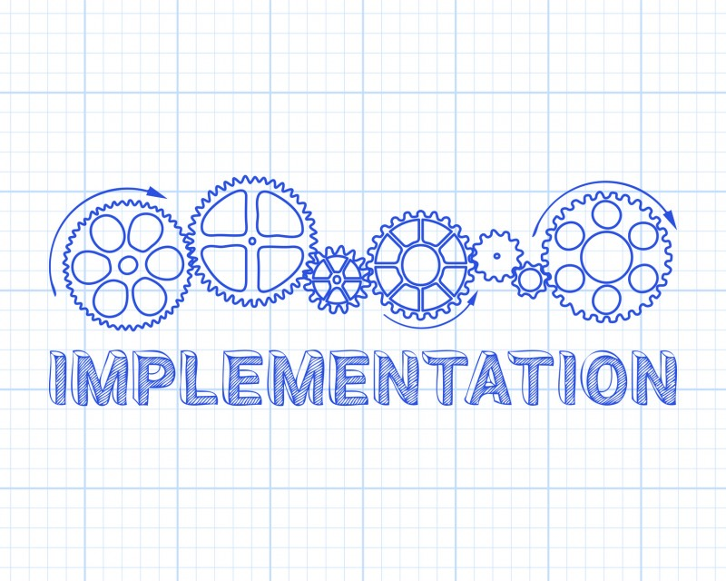
Contents

Slide 4


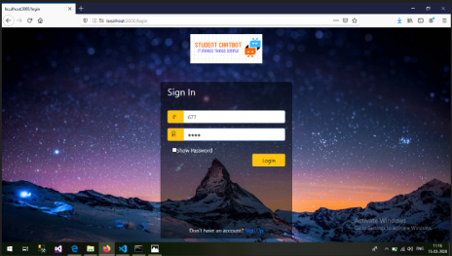

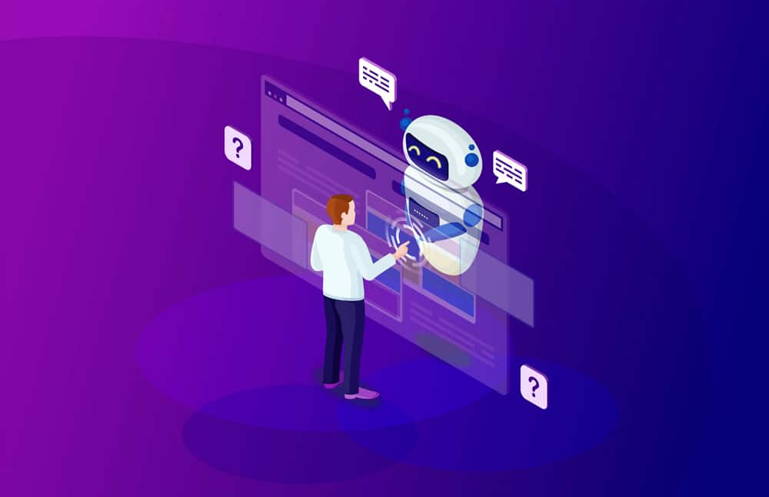
Design
User Home page Login Page
Output
Chatbot Database

Slide 5
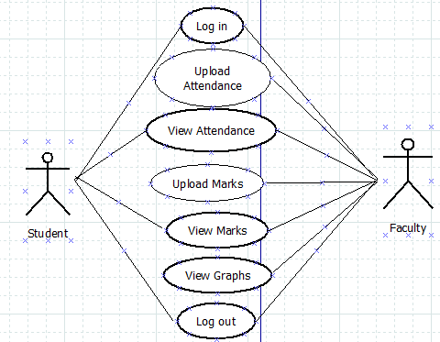
Cntd...
Use Case Diagram of Student and Faculty

Slide 6
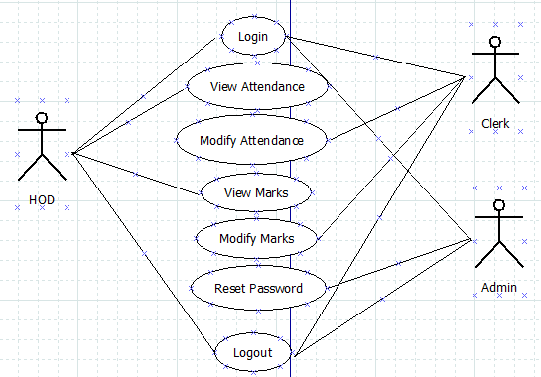
Cntd...
Use Case Diagram of HOD, Clerk and Admin

Slide 7
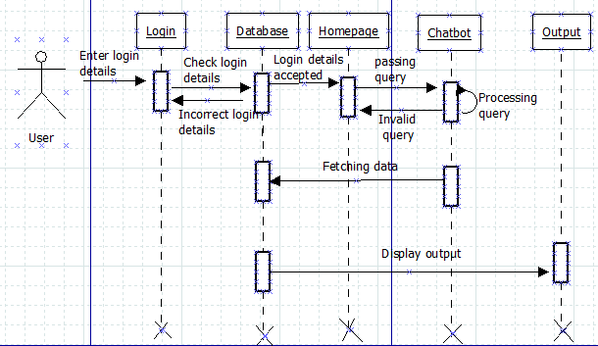
Cntd..
Sequence diagram

Slide 8
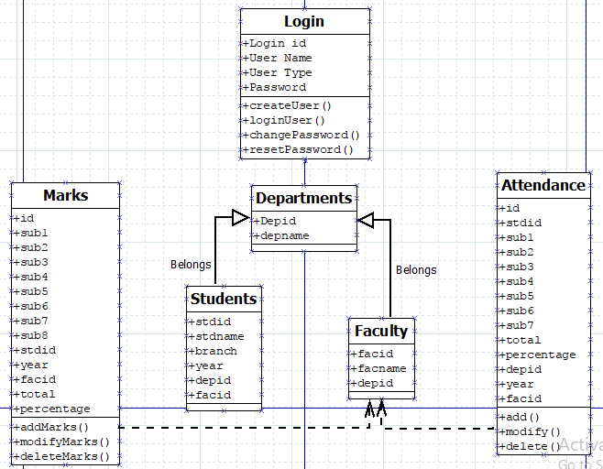
Cntd...
Class Diagram

Slide 9
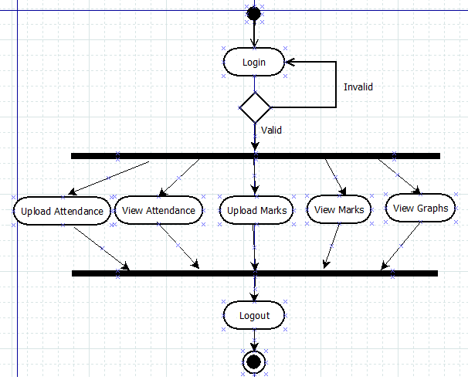
Cntd...
Faculty Activity Diagram

Slide 10
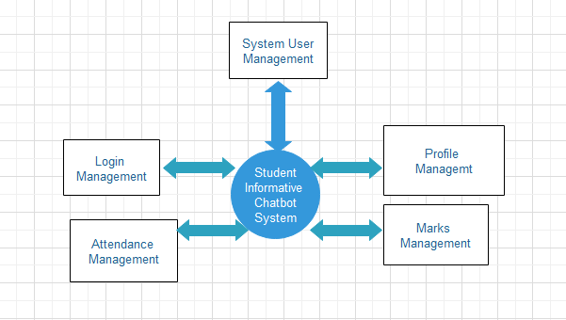
Data Flow Diagram
Zero Level DFD

Slide 11
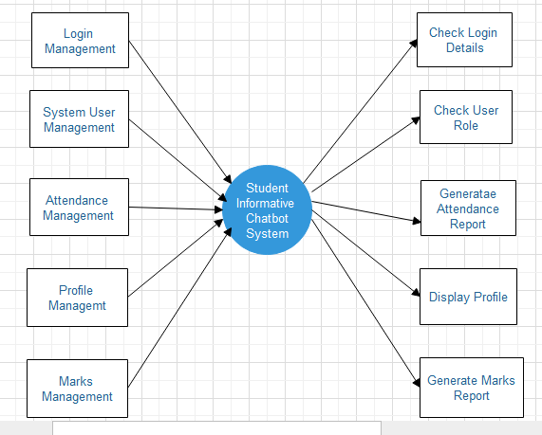
Cntd...
First Level DFD

Slide 12
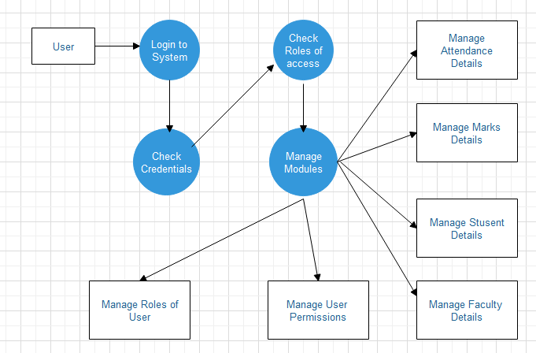
Cntd...
Second Level DFD

Slide 13
Implementation
Data Collection and Loading
Creating User modules
Assigning Permissions
Implementing Chatbot
Web Application

Slide 14
Cntd...
Data Collection and Loading
The Students details from 2nd year to 4th year are collected and loaded into the database.
Creating User Modules
The different modules of this chatbot system are student, faculty, HOD, clerk, admin, attendance, marks, profile, graphs, chatbot.

Slide 15
Cntd...
Providing permissions
The access permissions are provided to different users based on their roles.
Implementing chatbot
The chatbot is developed in python keeping in view of its users for more flexibility.
It receives the queries from the user, processes it and fetches the data from the database.
Python RegEx and NLP is used to provide flexibility to the user to communicate in natural language.
Web application
It is designed using html for the user interaction with the bot at front end.

Slide 16
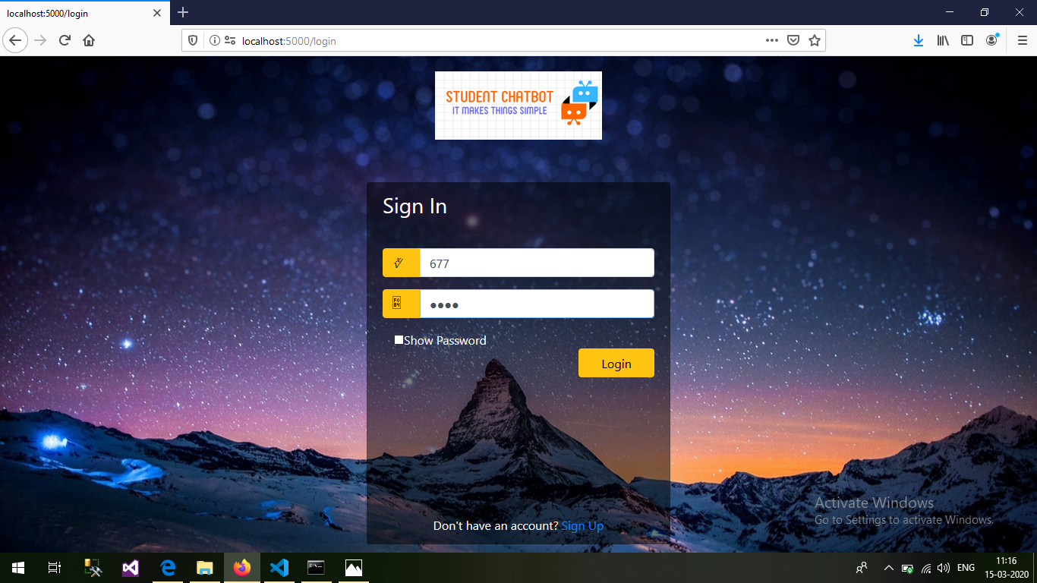
Login page

Slide 17
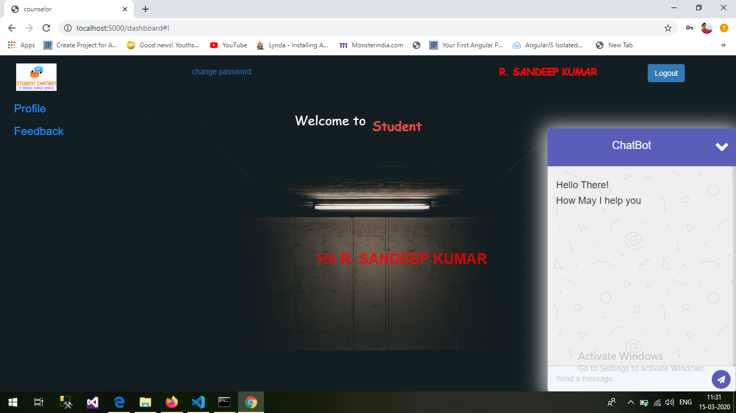
Chatbot

Slide 18
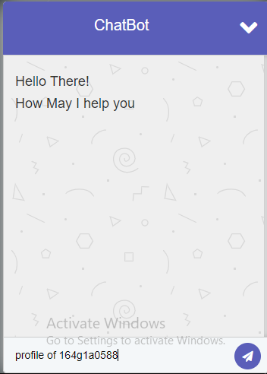
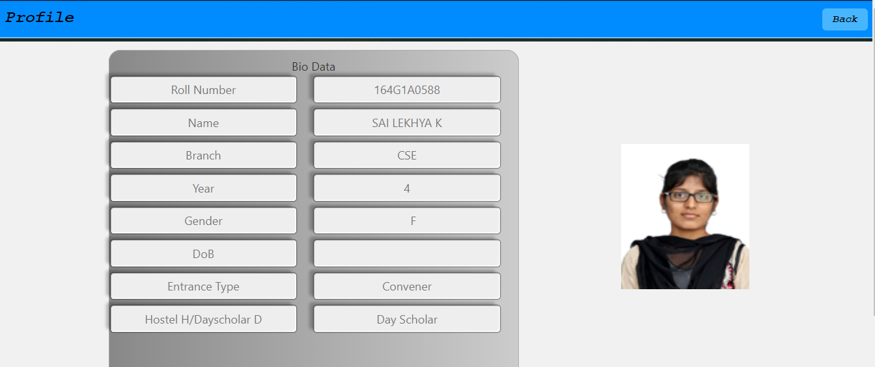
Profile

Slide 19
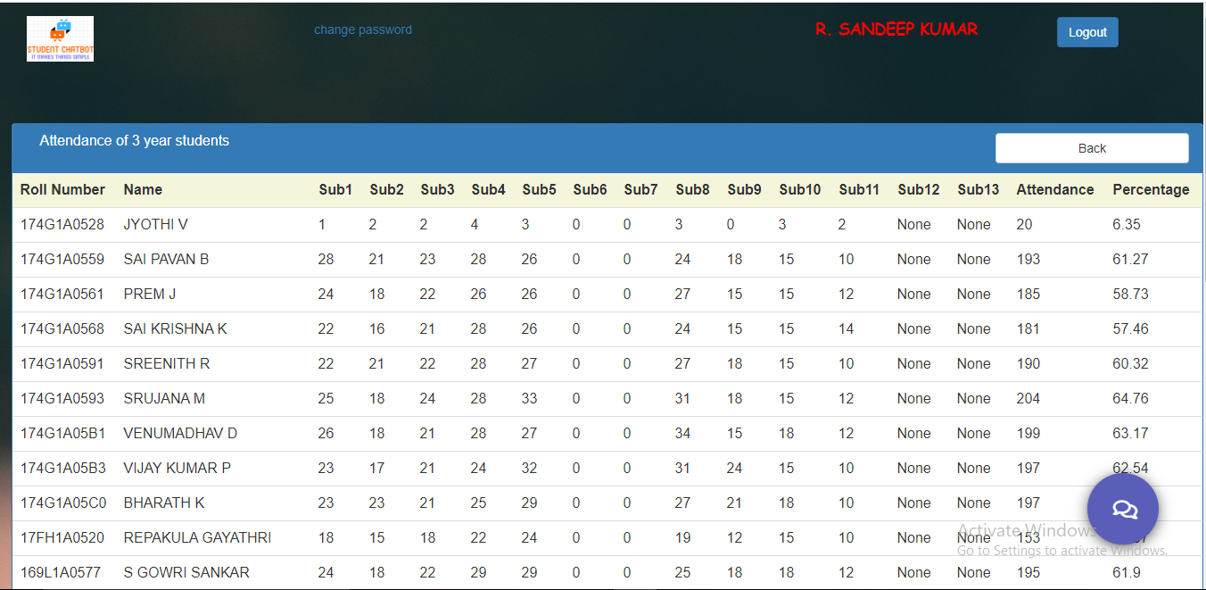
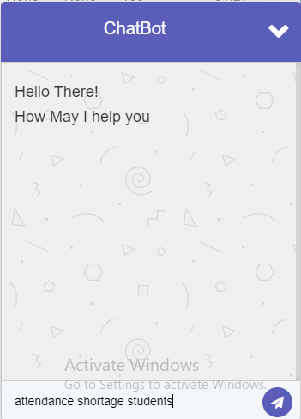
Attendance

Slide 20
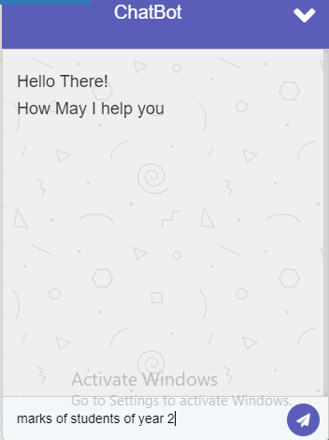
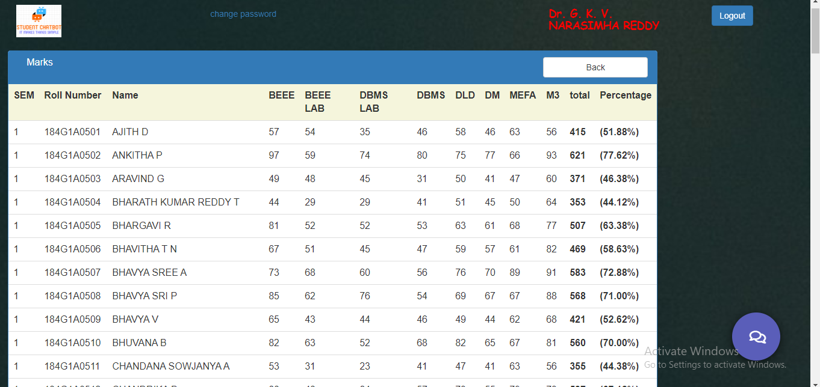
Marks

Slide 21
Review 2 Suggestions
If the requested query is not in the data base how are you going to deal with that
Add some graphs for comparative results of each batch

Slide 22
Queries
Thank you
?

